Slide 1
America’s History
Chapter 26

Slide 2
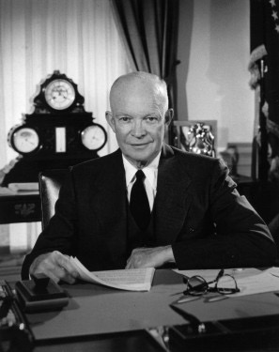


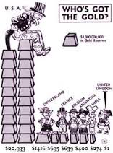
Postwar Prosperity and the Affluent Society
Economy: From Recovery to Dominance
  The Bretton Woods System:
    Creation of the World Bank - gave loans to countries in the 3rd world and those destroyed by war
    International Monetary Fund (IMF) - established to stabilize currencies around the world

Slide 3



Postwar Prosperity and the Affluent Society
  The Military-Industrial Complex
    Industries that benefitted from government contracts for military supplies
      Boeing, General Electric, etc.
    Eisenhower warned of the dangers of this in his Farewell Address
    Military spending increasingly consumed more of the nation’s GDP
    Soviet launch of Sputnik - led to the Space Race
      US passed the National Defense Education Act - increased funding for education, especially in science and math

Slide 4

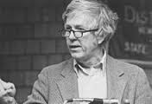
Postwar Prosperity and the Affluent Society
Economy: From Recovery to Dominance
  Corporate Power:
    Corporations grew in power and had a large share of their markets
    Mechanization replaced factory workers (Continuity - mechanization replaced farmers in the late 19th century)
  The Economic Record:
    The Affluent Society - argued that the poor were not the focus of politicians and economists
    The Other America - Michael Harrington - focused on the poor in America
      Helped influence LBJ’s Great Society in the 1960

Slide 5



Postwar Prosperity and the Affluent Society
A Nation of Consumers
  The 1950s could be compared to the 1920s - new consumer products, media (tv), and mass consumption
  The G.I. Bill:
    Provided education opportunities for returning soldiers
    Over 7 million veterans attended college or trade schools in the 1950s -> higher paying workforce
    Veterans Administration (VA):
      Provided home loans for veterans
  Trade Unions:
    Union membership increased in the 1940s
    Income rose for many workers in the 1950s
    Health insurance and pensions were provided through many contracts

Slide 6
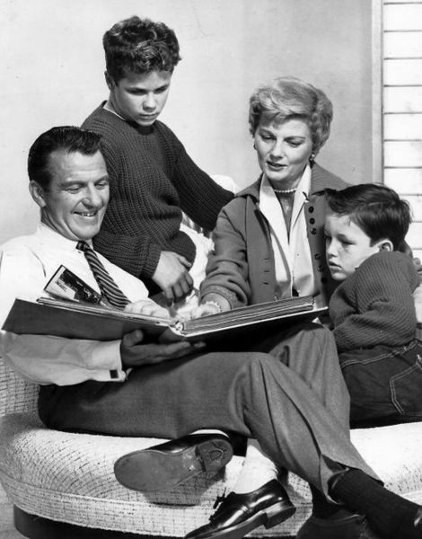



Postwar Prosperity and the Affluent Society
A Nation of Consumers
  Houses, Cars, and Children:
    Many families purchased homes and cars in the 1950s
    25 million homes between 1945 and 1970!
    Most homes had TVs, which promoted consumer products
  Television:
    TV shows focused predominantly on:
      White, middle-class, suburban families, where mothers were housewives
      Leave it to Beaver, Father Knows Best

Slide 7

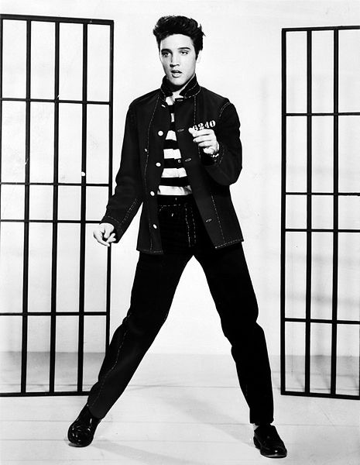


Postwar Prosperity and the Affluent Society
Youth Culture
  Teenagers were often targeted by advertisers to buy products
  Movies glorified young, rebellious men - Rebel Without a Cause
  Rock n’ Roll
    Alan Freed played “race” records over Cleveland airways
    Some of Elvis Presley’s songs were covers of black artists
  Cultural Dissenters:
    Beats (Beatniks, Beat Generation)
      Writers that criticized middle-class values and culture
      Similar to the Lost Generation of the 1920s (F. Scott Fitzgerald)
        Jack Kerouac - On The Road

Slide 8
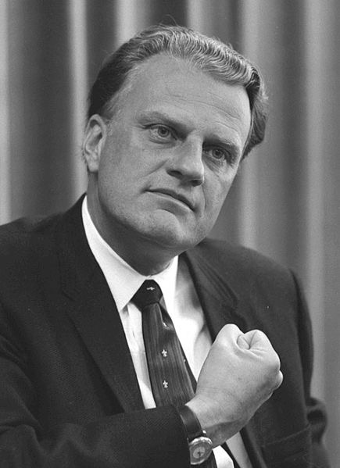
Postwar Prosperity and the Affluent Society
Religion and the Middle Class
  Billy Graham - influential evangelical preacher of the 1950s
    Argued that materialism was not incompatible with living a moral life
  In 1954, “Under God was added to the Pledge of Allegiance

Slide 9


The American Family in the Era of Containment
The Baby Boom
  1945 - 1964 (Birth control pill)
    Drop in divorces
  Impact of baby boom?
    Tighter job market in the 1970s
    Health care and Social Security issues today

Slide 10
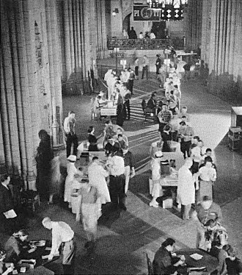
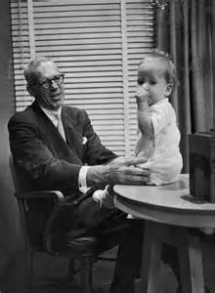
The American Family in the Era of Containment
  Improving Health and Education
    New medical advancements reduced mortality rates (and for children)
    Polio vaccine - Dr. Jonas Salk - gave it away for free!
  Dr. Benjamin Spock:
    Common Sense Book of Baby Child Care
      Argued that mothers be available for their children

Slide 11



The American Family in the Era of Containment
Women, Work, and Family
  Expectation of middle-class women in the 1950s?
    Raise children, clean the house, cook - “Cult of Domesticity”
    More women began working to help provide for families - most jobs included: nurses, receptionists, etc.
      Women were paid less than men
Women
Men

Slide 12

The American Family in the Era of Containment
Challenging Middle-Class Morality
  Alfred Kinsey:
    Researched sexual practices of Americans
    Americans were much more sexually active than most believed
  The Homophile Movement:
    Kinsey revealed that homosexuality was more common than believed, especially among men
    Homosexuals faced discrimination throughout the 1950s and 1960s
      1969 - Stonewall Riots - Gay Rights Movement began
  Media to Morality:
    Fear that comic books encouraged crime among youth
    Playboy was founded in 1953 - challenged societal norms

Slide 13
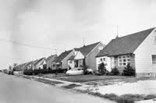


A Suburban Nation
The Postwar Housing Boom
  1 out of 3 Americans lived in suburbs by 1960
    Aided by cars, and highways
  William Levitt and the FHA
    Introduced mass-production of houses (Levittown)
      Cheap houses, similar styles, excluded African Americans
    Federal Housing Administration (FHA)
      Provided mortgages with little money down
      Helped increase home ownership drastically
    Despite the Supreme Court’s ruling, racial discrimination in housing persisted

Slide 14

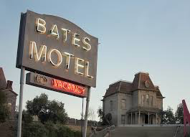
A Suburban Nation
The Postwar Housing Boom
  Interstate Highways
    National Interstate and Defense Highways Act
      Created under Eisenhower’s administration
      Over 42,000 miles of highways - would aid in a nuclear attack
        Led to the growth of hotel and food industries throughout

Slide 15


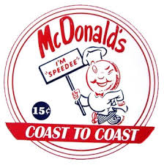

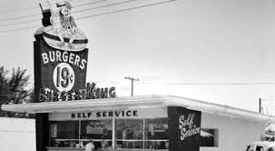
A Suburban Nation
  Fast Food and Shopping Malls
    Ray Kroc - purchased McDonald’s - used Taylorism techniques to mass produce hamburgers

Slide 16
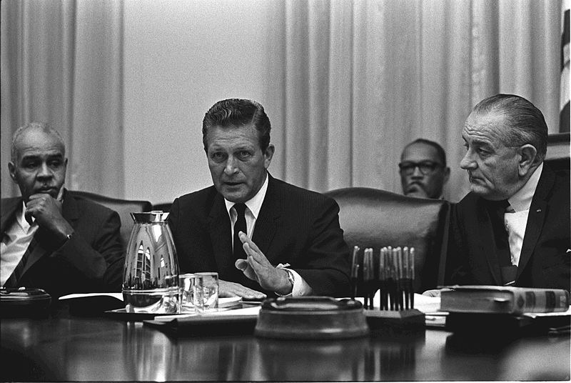
A Suburban Nation
Rise of the Sunbelt
  What is the Sunbelt?
    States located in the South and Southwest portion of the US
    Industries blossomed (especially military bases) - warm weather and low taxes
    A trend since WWII is an increase in population in Sunbelt states
Two Societies: Urban and Suburban
  As many whites moved to the suburbs (often referred to as “white-flight), African Americans moved to cities in large numbers
  Kerner Commission - government commission that stated the country is “moving towards two societies, one black, one white, separate and unequal.”

Slide 17
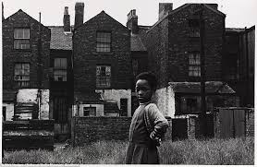
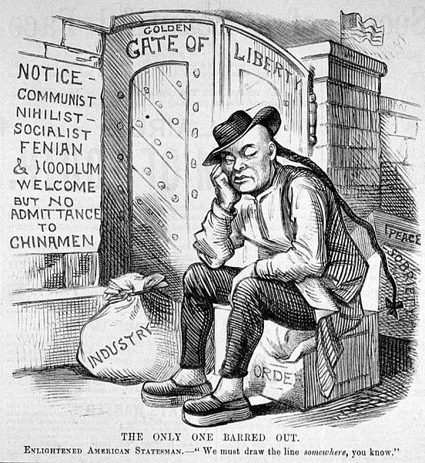
A Suburban Nation
The Urban Crisis:
  Many African Americans that lived in cities lived in old apartment buildings and received low paying jobs
  Urban renewal - push to destroy old buildings
Urban Immigrants:
  Chinese Exclusion Act was repealed in 1943
  Many Mexicans from the Bracero program remained in the US after it ended in 1964
  Puerto Ricans migrated to the US in large numbers
    Higher population in NYC than San Juan
  After Fidel Castro gained power in Cuba in 1959, many Cubans fled to the US, especially in Miami

Slide 18
The Recap
***Military-Industrial Complex***
The Affluent America
The GI Bill
Beatniks - similar to the Lost Generation
Short-term and long-term impacts of the Baby Boom Generation
The 1950s “family” and the role of women
Levittown and the FHA
Interstate Highways
Growth of the Sunbelt
White-flight and its impacts on cities

